Slide 1
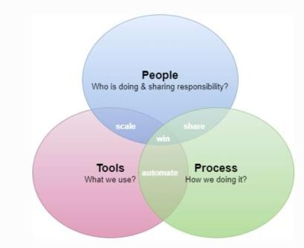







DevOps
People
Process
Tools
Culture
Interactions
Automation
Process:
Sequence or layers of procedures that is consisted of people, machines, materials, methods and governing policies that are used all together to design and delivery a good or service (product) . Conversion of an input into an output through-outprocedures.
Practice:
Series of steps to achieve a consistent result (output).
A simple process may be described by a single procedure. But a more complex process, will have multiple procedures.
BITS Pilani, Deemed to be University under Section 3 of UGC Act, 1956

Slide 2


Dimensions of DevOps
Three dimensions of DevOps People
Initially, stakeholders would need to be identified, ensuring that everybody delivering value to the business are working tightly together on the common goal of adding value to the customer.
Highly motivated people with good collaboration is necessary
Process
Process of designing, building and testing software should be well presented to each individual team member
Processes and practices that help improve the value and delivery to customers
Tools
Tools and services that can help enable different DevOps practices and different teams which can be used to make things easier
BITS Pilani, Deemed to be University under Section 3 of UGC Act, 1956

Slide 3


DevOps– People
Addresses the people aspect of adopting DevOps, including creating the necessary culture.
An organization may adopt the most efficient processes or automated
tools possible, but they’re useless without the people who eventually must execute those processes and use those tools.
DEVOPS CULTURE
(1) Identifying business objectives
Creating a culture is getting everyone direction and working toward the same goal
Identifying common business objectives organization as a whole.
headed in the same
for the team and the
identify goals that it wants to achieve; then it can develop a common set of milestones toward those goals for different teams
of stakeholders to use Collaboration and communication across
stakeholders
BITS Pilani, Deemed to be University under Section 3 of UGC Act, 1956

Slide 4
DevOps– People
2) Create an environment of sharing
leaders of the organization to work with their teams to create an environment and culture of collaboration andsharing.
Leaders must remove any self-imposed barriers to cooperation.
Typical measurements reward operations teams for uptime and stability, and reward developers for new features delivered, but they pit these groups against each other.
The leaders of the organization should further encourage collaboration by improving visibility. Establishing a common set of collaboration tools is essential, especially when teams are geographically distributed and can’t work together in person.
Giving all stakeholders visibility into a project’s goals and statusis
crucial for building collaboration.
a DevOps culture based on trust and
8
BITS Pilani, Deemed to be University under Section 3 of UGC Act, 1956

Slide 5
DevOps– People
DEVOPS TEAM
The arguments for and against having a separate DevOps team are as old as the concept itself.
DevOps liaison teams, which resolve any conflicts and promote collaboration.
Such a team may be an existing tools group or process group, or it may be a new team staffed by representatives of all teams that have a stake in the application being delivered.
DevOps team, your most important goal is to ensure that it functions as a Center of Excellence that facilitates collaboration without adding a new layer of bureaucracy or becoming the team that owns addressing all DevOps related problems
9
BITS Pilani, Deemed to be University under Section 3 of UGC Act, 1956

Slide 6
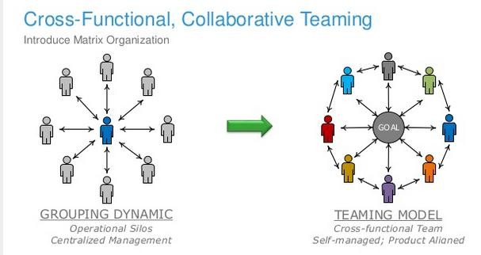
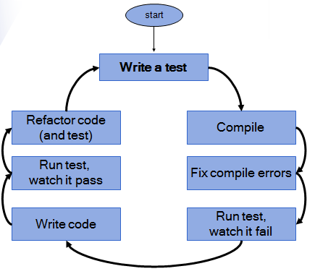

Test Driven Development
BITS Pilani, Deemed to be University under Section 3 of UGC Act, 1956

Slide 7
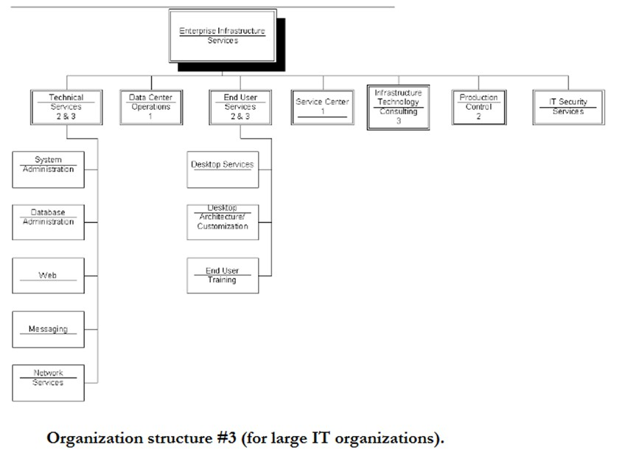
Test Driven Development
BITS Pilani, Deemed to be University under Section 3 of UGC Act, 1956

Slide 8
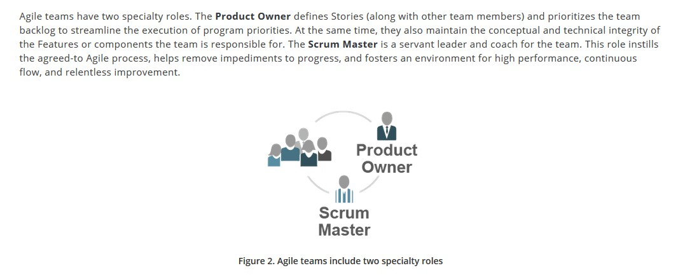
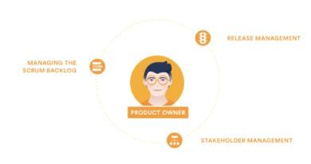
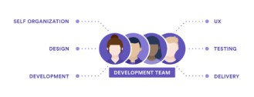
Agile Teams
BITS Pilani, Deemed to be University under Section 3 of UGC Act, 1956

Slide 9
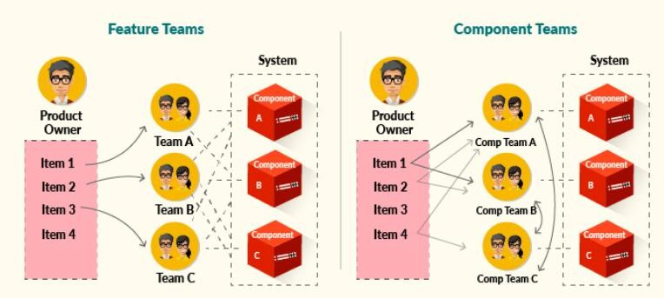
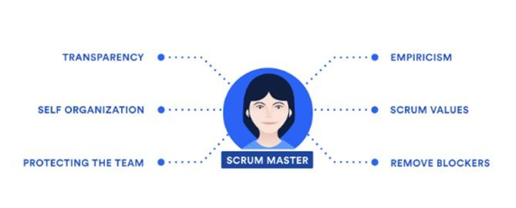
From Agile to DevOps
BITS Pilani, Deemed to be University under Section 3 of UGC Act, 1956

Slide 10
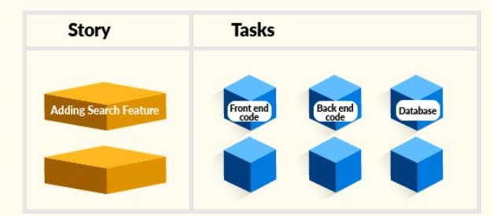
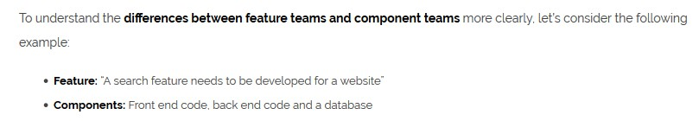
c
BITS Pilani, Deemed to be University under Section 3 of UGC Act, 1956

Slide 11
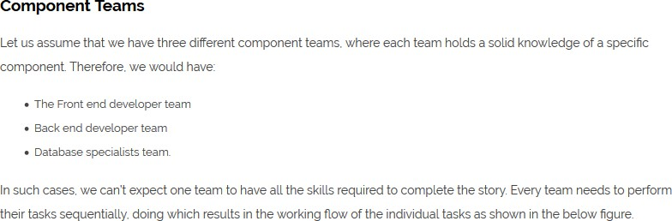
From Agile to DevOps
BITS Pilani, Deemed to be University under Section 3 of UGC Act, 1956

Slide 12
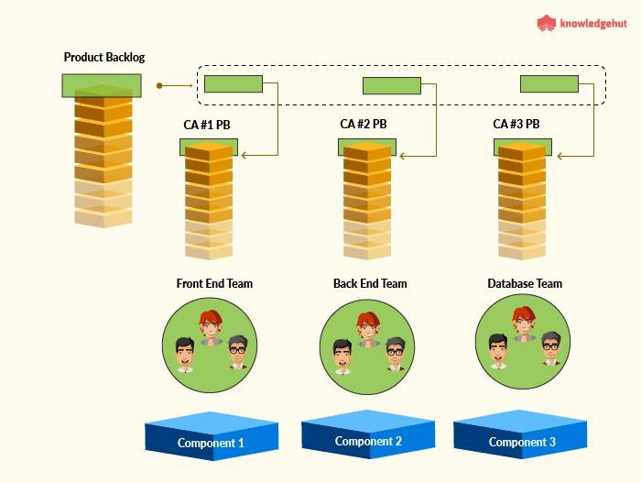
Component Teams
BITS Pilani, Deemed to be University under Section 3 of UGC Act, 1956

Slide 13
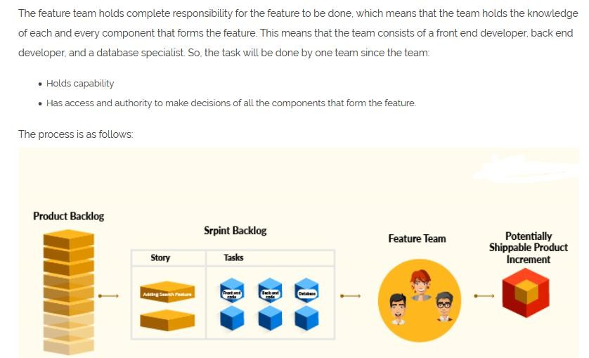
From Agile to DevOps
BITS Pilani, Deemed to be University under Section 3 of UGC Act, 1956

Slide 14
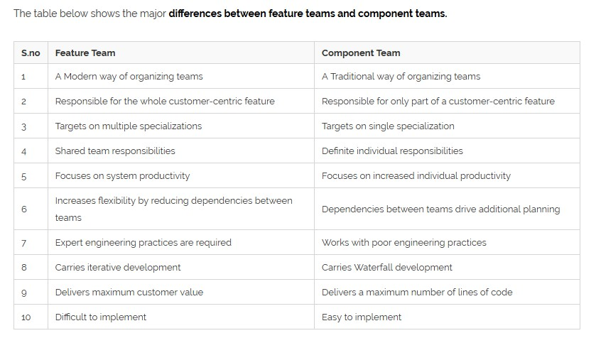
From Agile to DevOps
BITS Pilani, Deemed to be University under Section 3 of UGC Act, 1956

Slide 15
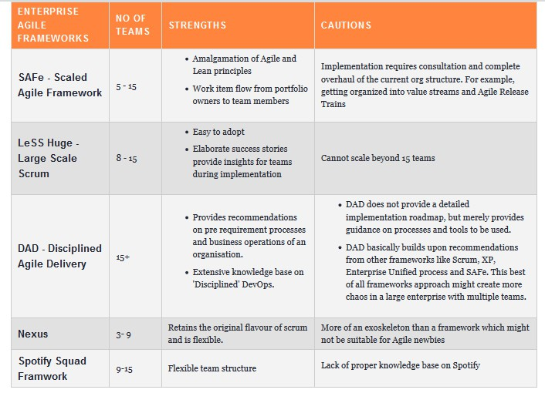
Infra evolution
BITS Pilani, Deemed to be University under Section 3 of UGC Act, 1956

Slide 16
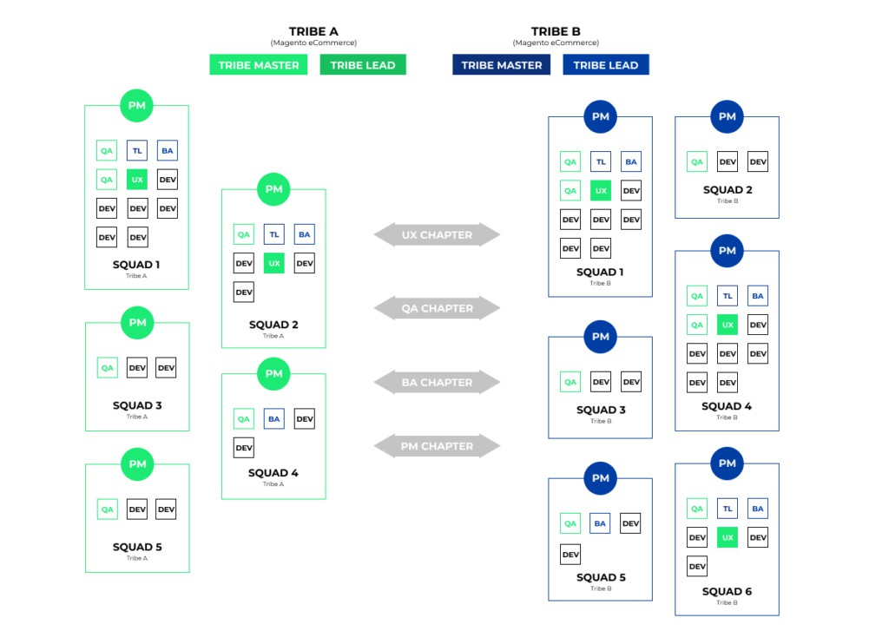
BITS Pilani, Deemed to be University under Section 3 of UGC Act, 1956

Slide 17
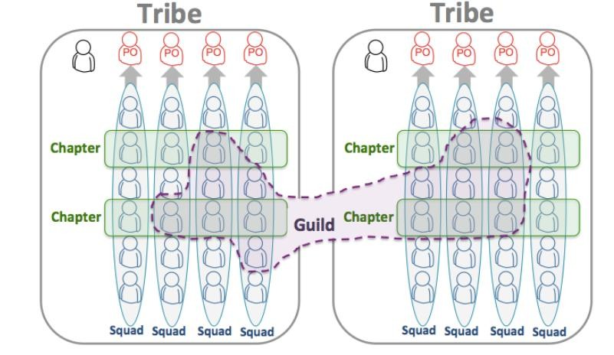
Squad
BITS Pilani, Deemed to be University under Section 3 of UGC Act, 1956

Slide 18
Squad
A Squad is similar to a Scrum team.
They sit together, and they have all the skills and tools needed to design, develop, test, and release to production.
They are a self-organizing team and decide their own way of working – some use Scrum sprints, some use Kanban, some use a mix of these approaches.
A tribe is a collection of squads that work in related areas – such as the web application, support, or backend infrastructure.
The chapter is your small family of people having similar skills and working within the same general competency area, within the same tribe.
A Guild is a more organic and wide-reaching “community of interest”, a group of people that want to share knowledge, tools, code, and practices. Chapters are always local to a Tribe, while a guild usually cuts across the whole organization
BITS Pilani, Deemed to be University under Section 3 of UGC Act, 1956

Slide 19
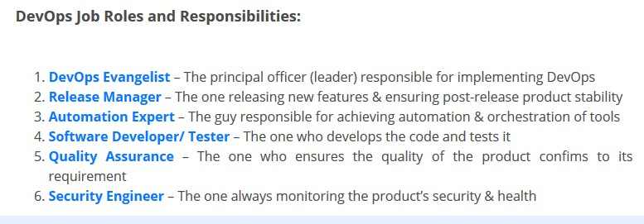
DevOps – Roles & Responsibilities
BITS Pilani, Deemed to be University under Section 3 of UGC Act, 1956

Slide 20

DevOps– People
Key competencies to succeed
Culture – Shared organizational assumptions to resolve problems Leadership
visioning, strategic management, flexibility, and the ability to inspire others to innovate and perform
individuals with advanced communications skills, the knowledge of diverse cultures, and people who behave collaboratively when working in teams
Resource/management
effective management of availableresources
collaboration across multi-functional teams is at the heart of DevOps, delivering an accountable business outcome
Subject matter experts (SME’s) in different areas like – Automation, Build &
Release management, CI/CD, Containers, Security, Cloud (AWS/GCP/Azure)
DevOps engineers who are members from different department
(development, QA, Operations )
10
BITS Pilani, Deemed to be University under Section 3 of UGC Act, 1956

Slide 21


DevOps– Tools
Enables people to focus on high-value creative work while delegating routine tasks to automation. Technology also allows teams of practitioners to leverage and scale their time and abilities. Organization has to reuse assets, code, and practices to be cost- effective and efficient.
Standardizing automation also makes people more effective common set of tools allows practitioners to work anywhere, and new team members need to learn only one set of tools and a process that’s efficient, cost-effective, repeatable, and scalable.
Categorized into major areas are Infrastructure as Code Delivery Pipeline
Deployment automation and release management
12
7
BITS Pilani, Deemed to be University under Section 3 of UGC Act, 1956

Slide 22
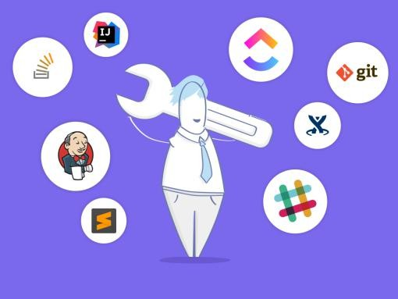
DevOps - Tools
BITS Pilani, Deemed to be University under Section 3 of UGC Act, 1956

Slide 23
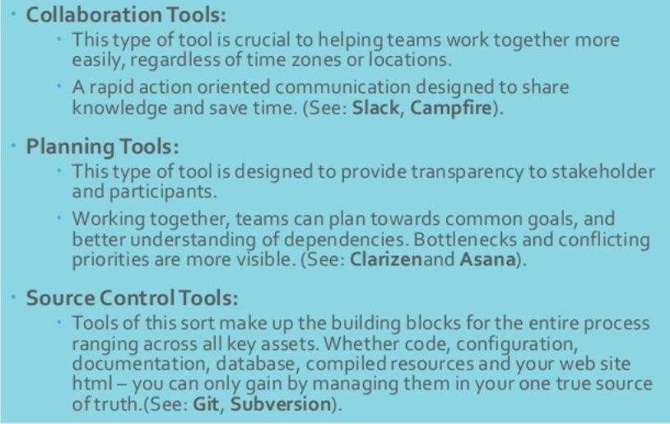
DevOps - Tools
BITS Pilani, Deemed to be University under Section 3 of UGC Act, 1956

Slide 24
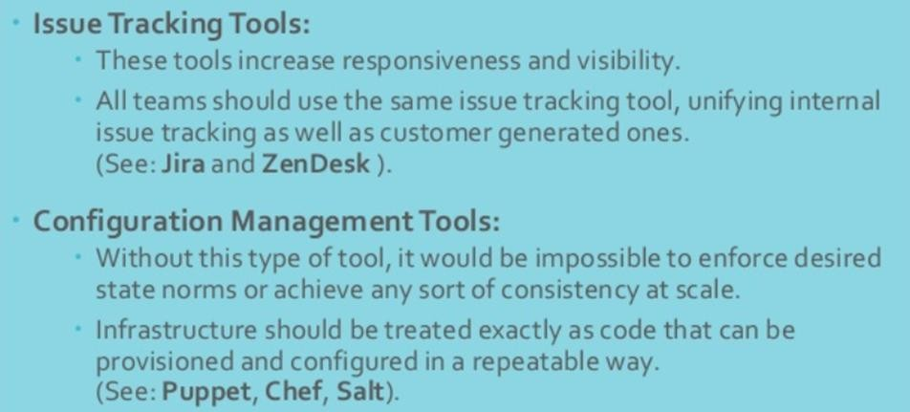
DevOps - Tools
BITS Pilani, Deemed to be University under Section 3 of UGC Act, 1956

Slide 25
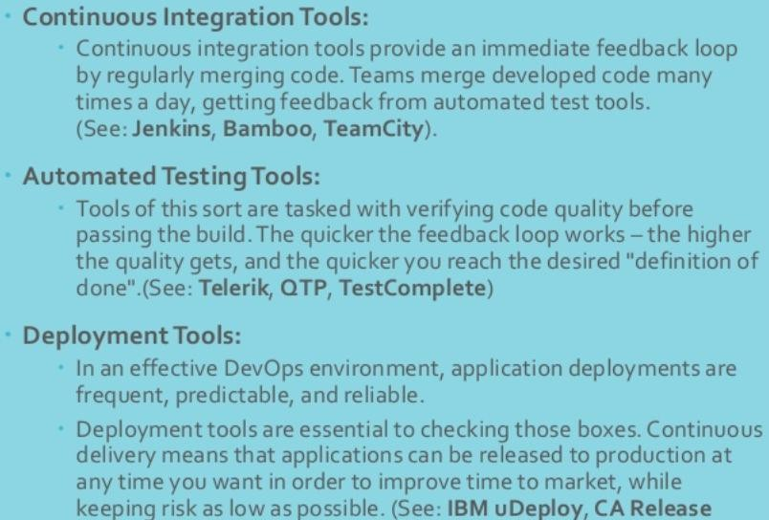
DevOps - Tools
BITS Pilani, Deemed to be University under Section 3 of UGC Act, 1956

Slide 26
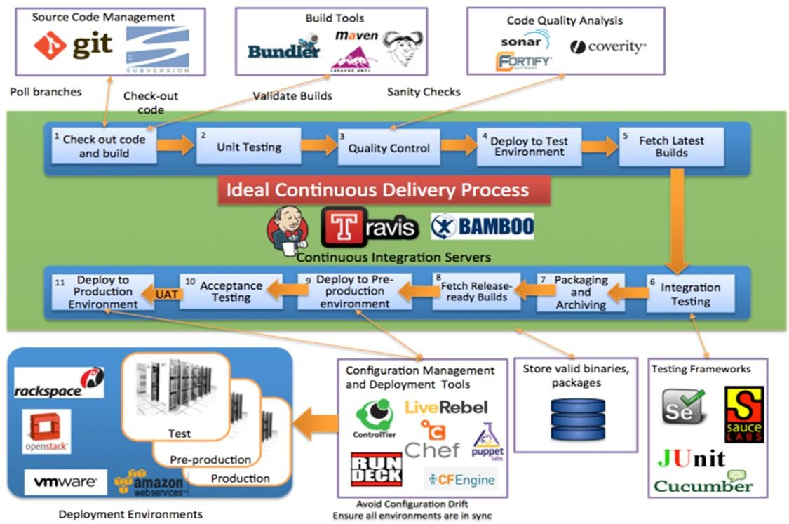
DevOps - Tools
BITS Pilani, Deemed to be University under Section 3 of UGC Act, 1956

Slide 27
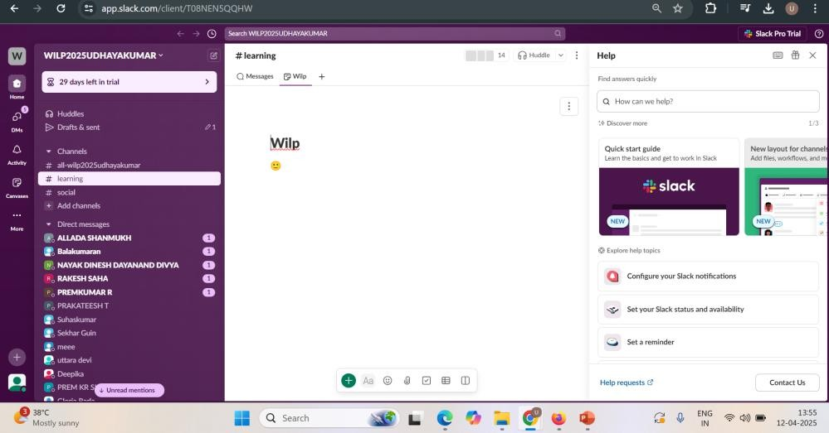
BITS Pilani, Deemed to be University under Section 3 of UGC Act, 1956

Slide 28
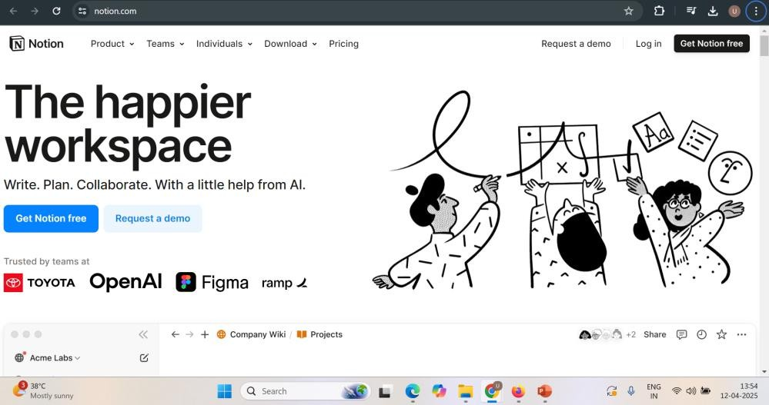
BITS Pilani, Deemed to be University under Section 3 of UGC Act, 1956

Slide 29
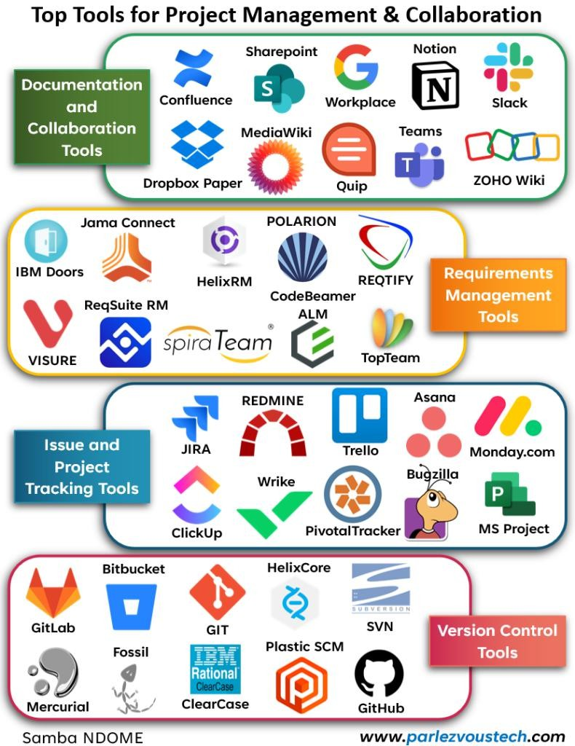
BITS Pilani, Deemed to be University under Section 3 of UGC Act, 1956

Slide 30
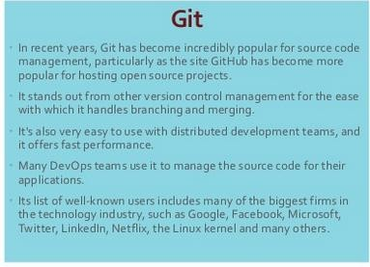
DevOps - Tools
BITS Pilani, Deemed to be University under Section 3 of UGC Act, 1956

Slide 31
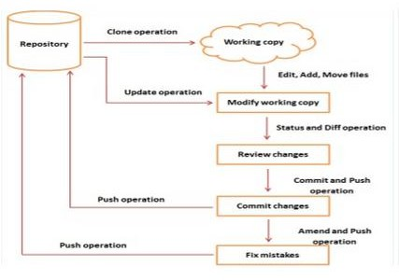
DevOps - Tools
BITS Pilani, Deemed to be University under Section 3 of UGC Act, 1956

Slide 32
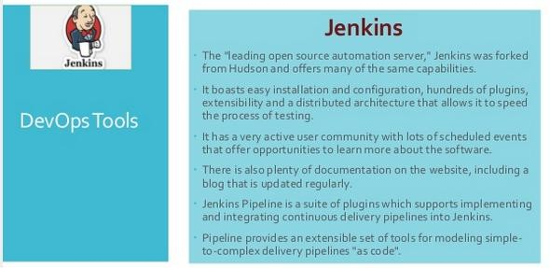
DevOps - Tools
BITS Pilani, Deemed to be University under Section 3 of UGC Act, 1956

Slide 33
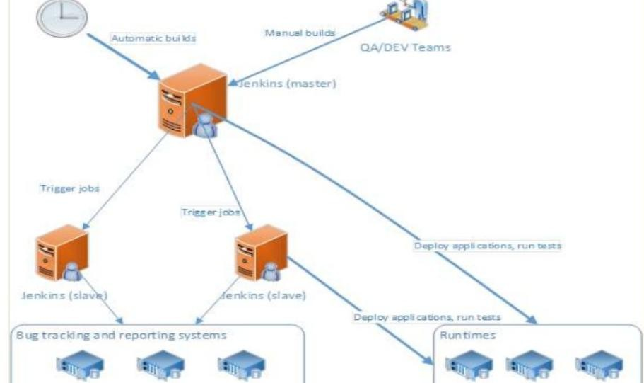
DevOps - Tools
BITS Pilani, Deemed to be University under Section 3 of UGC Act, 1956

Slide 34
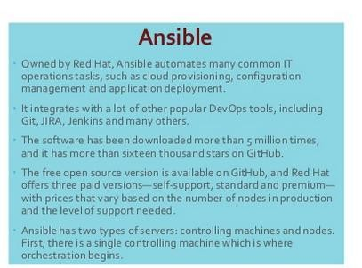
DevOps - Tools
BITS Pilani, Deemed to be University under Section 3 of UGC Act, 1956

Slide 35
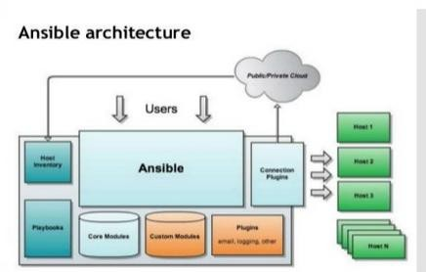
DevOps - Tools
BITS Pilani, Deemed to be University under Section 3 of UGC Act, 1956

Slide 36
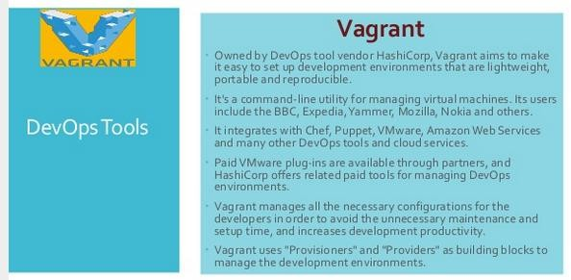
DevOps - Tools
BITS Pilani, Deemed to be University under Section 3 of UGC Act, 1956

Slide 37
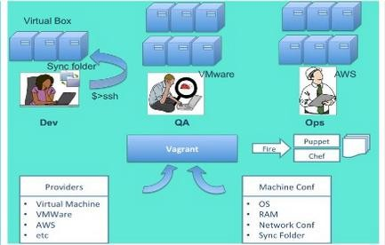
DevOps - Tools
BITS Pilani, Deemed to be University under Section 3 of UGC Act, 1956

Slide 38
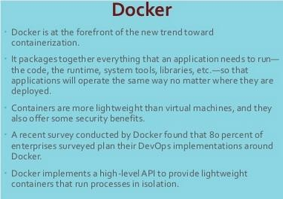
DevOps - Tools
BITS Pilani, Deemed to be University under Section 3 of UGC Act, 1956

Slide 39
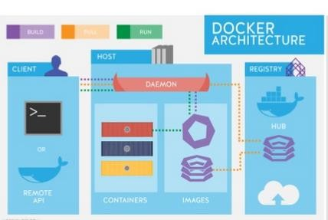
DevOps - Tools
BITS Pilani, Deemed to be University under Section 3 of UGC Act, 1956

Slide 40

DevOps– Infrastructure as Code
organizations to manage the scale and the speed with which environments need to be provisioned and configured to enable continuous delivery/deployment.
Infrastructure as code is the notion of software-defined environments
Infrastructure as code deals with capturing node definitions and configurations as code software-defined environments use technologies that define entire systems made up of multiple nodes not just their configurations, but also their definitions, topologies, roles, relationships, workloads and workload policies, and behavior.
Application or middleware-centric tools -code both application
servers and the applications that run on them. Automate server and application-level tasks
Generic tools -scripted to perform several kinds of tasks, all the way from configuring an OS on a virtual or physical node to configuring firewall
ports
23
BITS Pilani, Deemed to be University under Section 3 of UGC Act, 1956

Slide 41
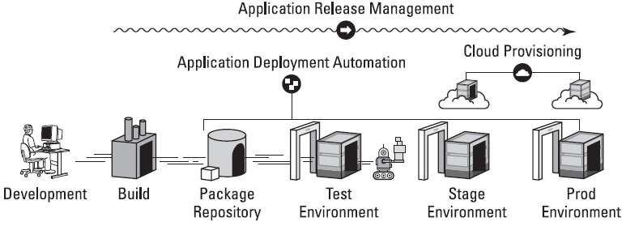
DevOps– Delivery pipeline
A delivery pipeline consists of the stages an application goes
through from development through to production
Stages may vary from one organization to another.
Some organizations fully automate their delivery pipelines; others put their software through manual checks and gates due to regulatory or company requirements.
BITS Pilani, Deemed to be University under Section 3 of UGC Act, 1956

Slide 42
DevOps– Delivery pipeline
Development environment
provides multiple tools that enable the developers to write and test code. Beyond the integrated development environment (IDE) tools
Developers use to write code, this stage includes tools that enable collaborative development, such as tools for source control management, work-item management, collaboration, unit testing, and project planning.
Tools in this stage typically are cross-platform and cross-technology.
Build stage
code is compiled to create and unit test the binaries to be deployed.
organizations typically use build servers to facilitate the large number of
builds required on an ongoing basis to enable continuous integration
BITS Pilani, Deemed to be University under Section 3 of UGC Act, 1956

Slide 43

DevOps– Delivery pipeline
Package repository (artifact repository)
common storage mechanism for the binaries created during the build stage need to store the assets associated with the binaries to facilitate their deployment, such as configuration files, infrastructure-as-code files, and deployment scripts
Test environment
QA, user acceptance, and development/ testing teams do the actual testing. Many tools are used
Test environment management: These tools facilitate provisioning and configuring the test environments.
Infrastructure-as-code technologies and cloud provisioning and management tools.
BITS Pilani, Deemed to be University under Section 3 of UGC Act, 1956

Slide 44
DevOps– Delivery pipeline
Test environment management
Environment (Infrastructure) Orchestration Tool
Build & Deployment Tools / Continuous Integration Tools Infrastructure Configuration Tools
Service Support Tools (Incident & Change) Environment Health Dashboards
Ex: Jenkins for app builds, Puppet for infrastructure configuration, CA Lisa for service virtualization
15
0
BITS Pilani, Deemed to be University under Section 3 of UGC Act, 1956

Slide 45
DevOps– Delivery pipeline
Test data management (TDM):
Administration of the data necessary for fulfilling the needs of
automated test processes.
TDM should also ensure the quality of at the correct time.
the data, as well as its availability
To enable continuous testing, managing test data is an essential function. Ex: IBM InfoSphere Optim , Informatica Test Data Management
Integration, functional, performance, and security testing tools: Automated tools are available for each of these types of tests.
Tools should be integrated with a common test asset management tool or repository where all test scenarios, test scripts, and associated results can be stored and traceability established back to code, requirements, and defects.
15
1
BITS Pilani, Deemed to be University under Section 3 of UGC Act, 1956

Slide 46
DevOps– Delivery pipeline
Service virtualization:
Modern applications aren’t simple, monolithic applications.
They’re complex systems that are dependent on other applications, application servers, databases, and even third-party applications and data sources.
Unfortunately, at test time, these components may be unavailable or costly.
Service virtualization solutions simulate the behavior — functionality and performance of select components within an application to enable end- to-end testing of the application as a whole.
Create stubs (virtual components) of the applications and services that are required for the tests to run.
Ex: IBM’s Rational Test Virtualization Server, Soap UI, Microfocus
15
2
BITS Pilani, Deemed to be University under Section 3 of UGC Act, 1956

Slide 47
DevOps– Delivery pipeline
Stage and production environments
Applications are deployed in the staging and production
environments.
Tools used in these stages include environment management and provisioning tools.
Tools for infrastructure as code also play a critical role in these stages, due to the large scale at which the environment in these stages exist.
With the advent of virtualization and cloud technologies, stage and production environments can today be made up of hundreds or even thousands of servers. Monitoring tools allow organizations to monitor the deployed applications in production.
BITS Pilani, Deemed to be University under Section 3 of UGC Act, 1956

Slide 48

DevOps– Deployment automation and release management
Managing the automation of application deployment from one stage to the next requires specialized tools
Deployment automation Core tools in the DevOps
Perform orchestrated deployments and track which version is deployed on which node at any stage of the build and delivery pipeline
Can also manage the configurations of the environments of all the stages to
which the application components must be deployed.
Manage
Middleware components middleware configurations
Database components that need to be changed;
Environment configuration
capture and automate the processes to carry out these deployments and configuration changes.
BITS Pilani, Deemed to be University under Section 3 of UGC Act, 1956

Slide 49
DevOps– Deployment automation and release
management
Release management
Orchestrating the release plans and deployments associated with each release requires coordination across the business, development, QA, and operations teams.
Release management tools allow organizations to plan and execute releases,
provide a single collaboration portal for all stakeholders in a
release, and provide
traceability for a release stages of the build and
and its delivery
components across all pipeline.
15
5
BITS Pilani, Deemed to be University under Section 3 of UGC Act, 1956

Slide 50





DevOps– Cloud as a catalyst
Essential Characteristics
Scalability:
Ability to system to handle increasing workload by increasing in
proportion the amount of resource capacity.
Architecture allows on-demand resources for increasing workload
Elasticity:
Dynamically Commissioning and decommissioning of resources
Speed at which resources are provisioned on demand and usage of resources
On-demand Self-service
Resource pooling
Broad network access
Rapid Elasticity
Measured Service
33
BITS Pilani, Deemed to be University under Section 3 of UGC Act, 1956

Slide 51



DevOps– Cloud as a catalyst
Private Cloud
Private Cloud: The infrastructure is operated solely for an organization. It may be managed by the organization or a third party and may exist on or off the premises of the organization.
Public Cloud
Public Cloud: The infrastructure is made available to the general public or a large industry group and is owned by an organization selling cloud services.
Hybrid Cloud: The infrastructure is a composition of two or more clouds
(private, community, or public) that remain unique entities but are bound together by standardized or proprietary technology that enables data and application portability.
Hybrid Cloud
BITS Pilani, Deemed to be University under Section 3 of UGC Act, 1956

Slide 52
Virtualization
A virtual machine (VM) is a software implementation of a machine (for example, a computer) that executes programs like a physical machine
Each VM is fully protected and isolated copy of physical machine. It is used to share
the expensive hardware which helped to reduce costs and also helped to improve the productivity as many users can concurrently used the same hardware
Need for Server virtualization
In the case of server consolidation, many small physical servers are replaced by one larger physical server to increase the utilization of costly hardware resources such as CPU.
A virtual machine can be more easily controlled and inspected from outside than a physical one, and its configuration is more flexible.
A new virtual machine can be provisioned as needed without the need for an
up- front hardware purchase.
BITS Pilani, Deemed to be University under Section 3 of UGC Act, 1956

Slide 53
Container
Containers and VMs
To isolate an application and its dependencies into a self-contained unit that can run anywhere
Remove the need for physical hardware, allowing for more efficient use of
computing resources, both in terms of energy consumption and cost effectiveness.
Containers
virtualize at the operating system level, with multiple containers running atop the OS kernel directly
container provides operating-system-level virtualization by abstracting the “user space”
ability to create predictable environments that are isolated from other applications
run virtually anywhere, greatly easing development and deployment
virtualize CPU, memory, storage, and network resources at the OS-level, providing developers with a sandboxed view of the OS logically isolated from other applications.
Ex: Docker, LXC, Kubernetes, FreeBSD Jails etc..
BITS Pilani, Deemed to be University under Section 3 of UGC Act, 1956

Slide 54

DevOps– Cloud as a catalyst
Cloud is key enabler and has affected DevOps. It helps DevOps to mature.
In traditional organizations that use physical servers, requesting a new server is a complex, time-consuming process. It may take days or even weeks to requisition a new physical server, install and set up the operating system (OS), and configure all the software required to deploy the application.
Pervasiveness of cloud technology, private, public, and hybrid, has enabled organizations to provision environments on demand.
Virtualization in Cloud solve that problem to a large extent. This has led to
tremendous growth in the scale by which the environments to which applications are deployed are used.
This scale has necessitated automation on software deployment tasks, which DevOps addresses
Ability to create and switch environments simply, the ability to create VMs
easily, and the management of databases etc..
BITS Pilani, Deemed to be University under Section 3 of UGC Act, 1956

Slide 55
DevOps– Cloud as a catalyst
advent of cloud actually facilitates continuous deployment and provides easier access to production like environments during the development and testing stages of the deliverypipeline.
Developer can not only invoke an automated build, but also request the provisioning and configuration of a production like environment in the cloud and then deploy the application being built to it without any direct involvement by the operations team.
BITS Pilani, Deemed to be University under Section 3 of UGC Act, 1956

Slide 56
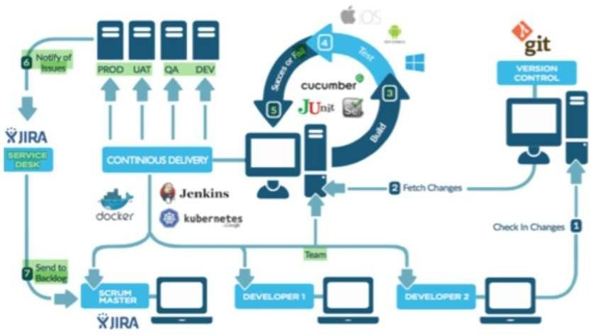
DevOps– Cloud as a catalyst
BITS Pilani, Deemed to be University under Section 3 of UGC Act, 1956

Slide 57
DevOps– Tools/technology as
enablers
Phase | Purpose | Tools
Development | Source control | Git, SVN, CVS
 | Static Code Analysis | SonarQube, FindBugs, CheckStyle,PMD
 | CI | Jenkins, pupper, cruise control,Anthil
Testing | Unit and Performance | Junit, TestNG,Jmeter,Selenium,cucumber, SOAP UI,HtmlUnit
 | Code Coverage | Jacaco, Cobertura
Release | Build and Release | ANT, Maven, Gradle
Deployment | Deployment Automation | Jenkins plugin,deployment scripts
Monitoring and Maintenance | Continuous monitor | Web analytics scripts, health monitoring tools, server monitoring tools
40
BITS Pilani, Deemed to be University under Section 3 of UGC Act, 1956

